Slide 1
Power

Slide 2
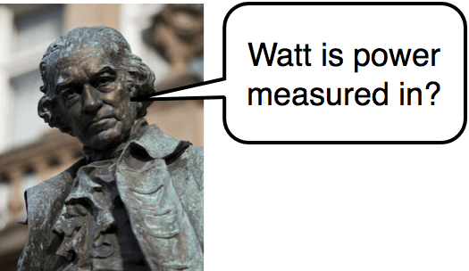
In this Smart Lesson you will learn to:
Define power.
Solve problems involving power.

Slide 3


Power is defined as the rate at which work is done or the rate at which energy is transferred or transformed.
Power is calculated using the following equations:
Where P is power, W is work, t is time and E is energy. The delta symbol Δ is used to represent a change in a value.

Slide 4
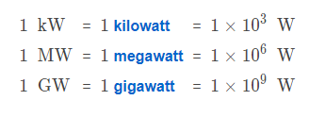
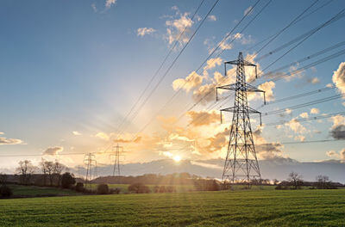
The SI unit for power is W (Watts).
One watt is equal to one Joule per second (Js⁻¹) or one Newton-metre per second (Nms⁻¹).
Our homes use massive amounts of power, so we often use large units to measure these.

Slide 5

The power output of a car's engine is one of the factors which determines the top speed of the car.
In order to keep the car travelling at a constant speed, the engine must convert energy stored in the fuel to other forms of energy.
Air resistance increases as the car goes faster, decreasing the energy of the car as it does work. This means that as the car goes faster, the power needed increases.
P = Fv
This formula is derived from another definition of power. It shows that power is equal to the force applied to the object multiplied by the velocity of the object.

